Slide 1


[Title]

Slide 2


Today's agenda
Project Recap – About the Social Buzz Company, project with Accenture.
Problem – Number of post every day, highly unstructured data, analyzing top 5 categories.
The Analytics Team – Name of People and their designations who are handling Project
Process – Gathering required information, Data Cleaning, Data Modelling, Getting Insights.
Insights – Number of unique categories, Most reaction to particular category, Month with most post.
Summary - Analysis, Insights and Next Step.

Slide 3

About our Client
Social Buzz is one of the fastest growing company in social media & content creation industry, providing platform to content creators, which has reached over 500 million active users each month, which has scaled quicker than anticipated and that’s why they need help of an advisory firm to oversee their scaling process effectively.
Project
Accenture is running a 3-month initial project to fulfil their expectations as per assigned tasks:
An audit of their big data practice
Recommendations for a successful IPO
An analysis the top 5 content categories with the largest popularity.
Project Recap

Slide 4

Problem
Over 100,000 pieces of content Every day
All of this data is highly unstructured.
Analysis to find out the Top 5 performing categories

Slide 5



Myself
(Data Analyst)
The Analytics team
Marcus Rompton
(Senior Principle)
Andrew Fleming
(Chief Technical Architect)

Slide 6
Process
1. Data Understanding
2. Data Cleaning
3. Data Modelling
4. Data Analysis
5. Insights from Data

Slide 7

Insights -
16
UNIQUE CATEGORIES
1897
REACTION TO (ANIMAL) CATEGORY
MAY
MONTH WITH MOST
NUMBER OF POST

Slide 8
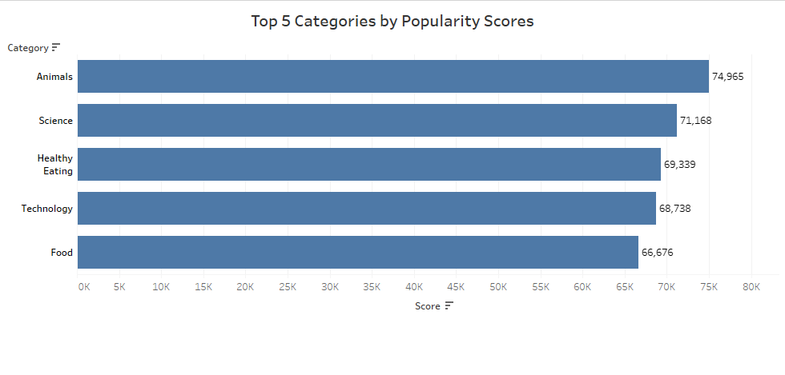

Slide 9
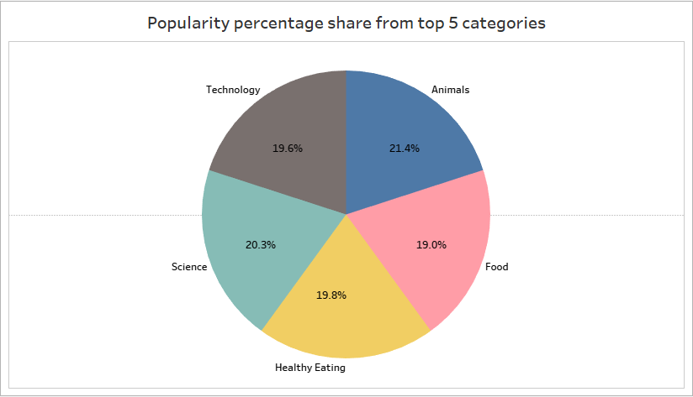

Slide 10

ANALYSIS
Animal and Science are two most popular categories of content, indicating that the audience enjoy (Real-life) and (Scientific) content the most.
INSIGHT
Food is a common topic in top 5 categories under which “Healthy Eating” segment is ranking highest which may be an indication to the audience within the user base. Using this insight, a campaign can be organized by working with healthy eating brands to boost user engagement and audience experience.
NEXT STEP
This ad-hoc analysis is insightful, but now it’s time to take this analysis into large scale production for real-time understanding of your business. We can show you how to do this.
Summary

Slide 11
Thank you!
ANY QUESTIONS?

